Slide 1

TELECOM CUSTOMER CHURN PREDICTION

Slide 2
Group members.
Ms Komal Nikole
Ms Misba Pathan
Mr Nitish Rajendra Kale
Mrs Avanti Chinmay Kulkarni
Yenugupalli Sarath Chandra
Mr Kshitij Adesh Jadhav

Slide 3
Introduction:
Churn prediction is one of the most popular Big Data use cases in business. It consists of detecting customers who are likely to cancel the subscription to a service.
Churn is a problem for telecom companies because it is more expensive to acquire a new customer than to keep your existing one from leaving.

Slide 4
Project Objective:
Customer churn is a big problem in any industry and one of the most important concerns for the Telecom industry.
It costs 5-10 times more to acquire a new customer than to retain an existing one, that's why customer retention has now become even more important than customer acquisition.
The main objective of this project is to model churn probability, conditioned on the customer features.
Apart from this the objective includes:
Finding factors that influence the customer churn.
Providing offers based on these affecting factors.
Retain the existing customers.
Applying strategies and introducing different plans to minimize the customer churn.

Slide 5
Dataset:
The available dataset consists of the information regarding the Customer churn in a telecom company.
The dataset consists of 5000 rows and 20 columns/attributes.
The attributes have different datatypes such as ‘object’,’int64,’float’.
Each row corresponds to a client of a telecommunications company for whom it has collected information about the type of plan they have contracted, the minutes they have talked, or the charge they pay every month.
The data set includes the following variables:
state: Categorical, for the 51 states and the District of Columbia.
Area.code
account.length: how long the account has been active.
voice.plan: yes or no, voicemail plan.
voice.messages: number of voicemail messages.
intl.plan: yes or no, international plan.
intl.mins: minutes customer used service to make international calls.
intl.calls: total number of international calls.
intl.charge: total international charge.
day.mins: minutes customer used service during the day.
day.calls: total number of calls during the day.
day.charge: total charge during the day.
eve.mins: minutes customer used service during the evening.
eve.calls: total number of calls during the evening.
eve.charge: total charge during the evening.
night.mins: minutes customer used service during the night.
night.calls: total number of calls during the night.
night.charge: total charge during the night.
customer.calls: number of calls to customer service.
churn: Categorical, yes or no. Indicator of whether the customer has left the company (yes or no).

Slide 6
Project Flow:
Data Collection
EDA
and preprocessing
Feature Extraction
Building Prediction Models
Train,Test,
Validate
the Model
Evaluation of Model
Model Deployment

Slide 7

EDA
(Exploratory Data Analysis)

Slide 8
Data Processing
The data consists of 5000 rows and 20 columns.
We observe that 7 attributes have 'object' datatype.
The attributes 'voice_plan’, 'intl_plan’, 'Churn’ were to be converted to binary.
The datatype of the attributes 'day_charge’, 'eve_mins’ were converted from object to ‘float’.
After the above processing, we checked for the null values and found total 31 null values were present in the dataset. This figure is only 0.62% of the total data. Here , these null values are filled with the mean of that particular column.
Also, the dataset does not contain any duplicate values.

Slide 9
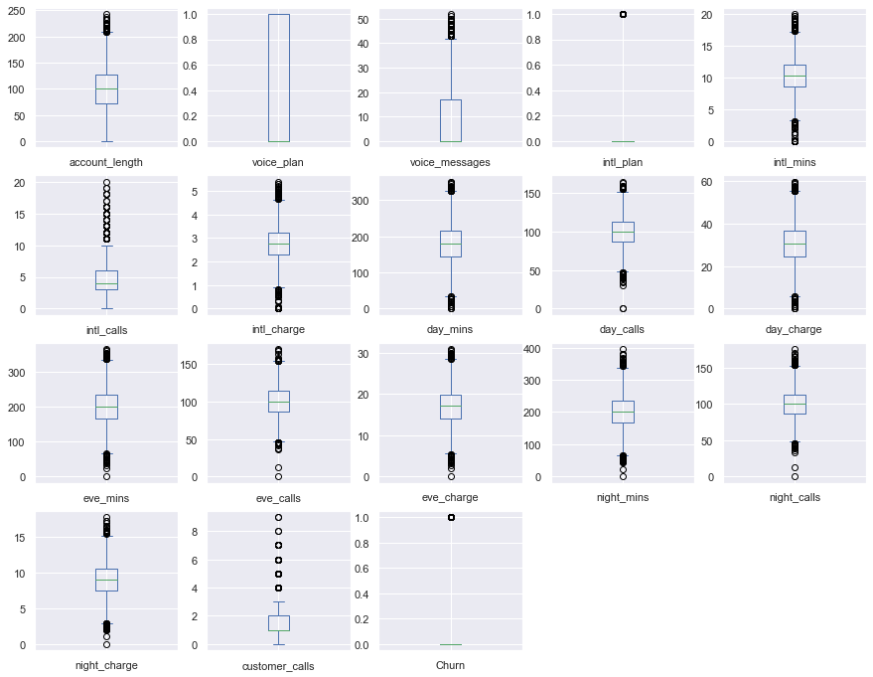
Data Visualization
Box plot
From the box plot, it is observed that the columns of our dataset contain outliers.

Slide 10
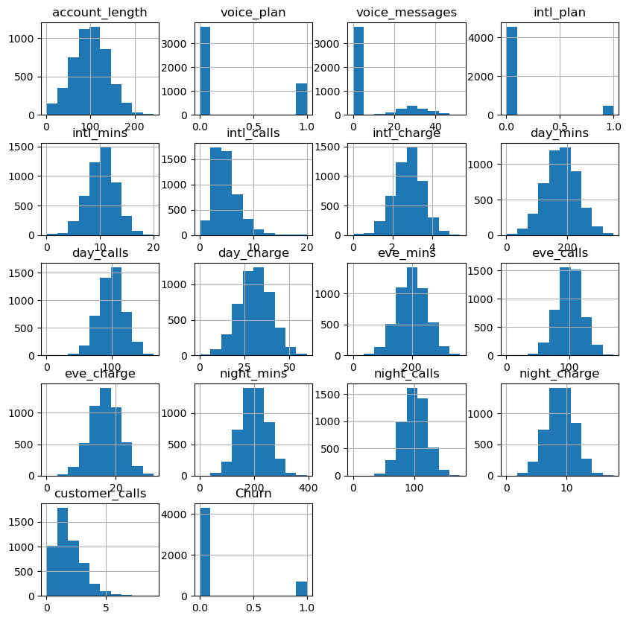
Histogram
From the histograms, we observe that all the attributes are almost normally distributed.
Only,’intl_calls’, ‘cust_calls’ seems to be slightly skewed.

Slide 11
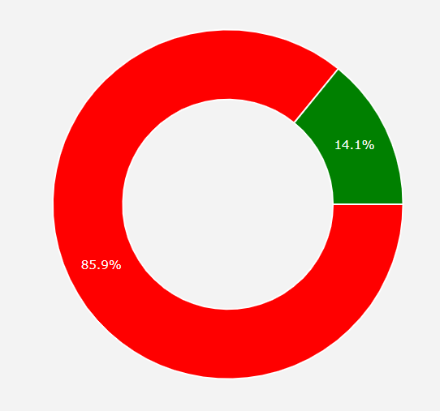

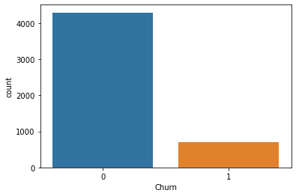
Overall Churn Rate
From the total customers,14.1% have opted to churn whereas 85.9% customers are continuing with services. Although, this rate appears to be less but it will cumulatively affect the company’s revenue .

Slide 12
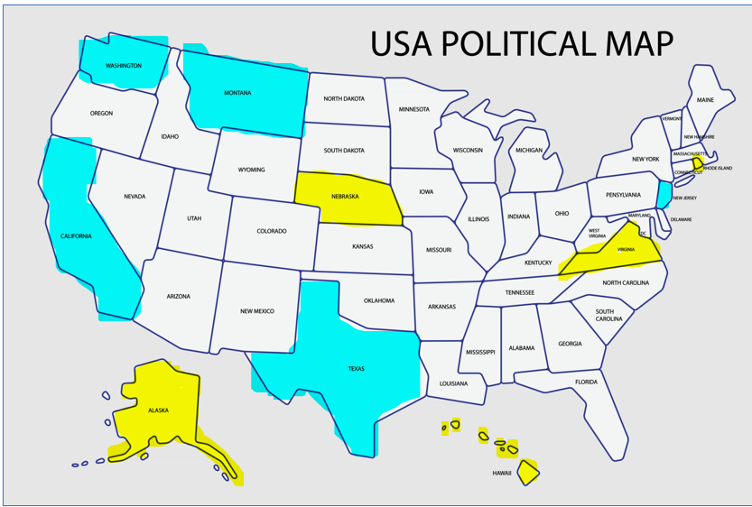
Churn Rate by State
California, NewJersey, Washington, Texas and Montana are the 5 highest churning states.
Whereas Virginia, Hawaii, Nebraska, Alaska and Rhode Island are the 5 least churning states.

Slide 13
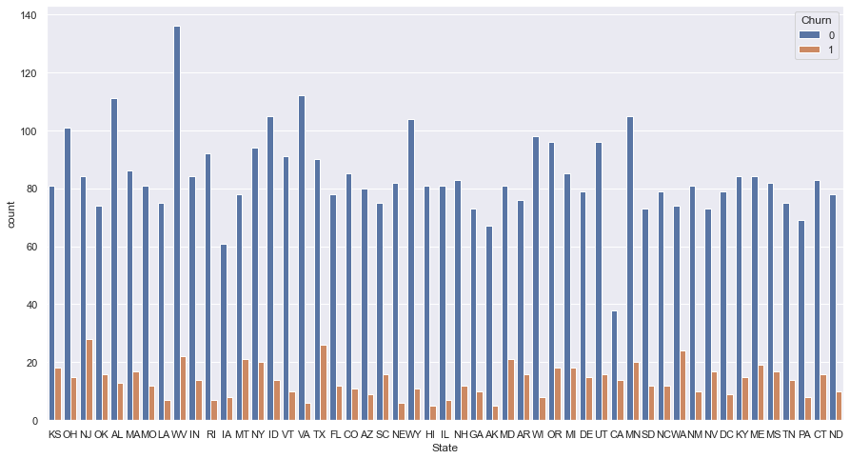
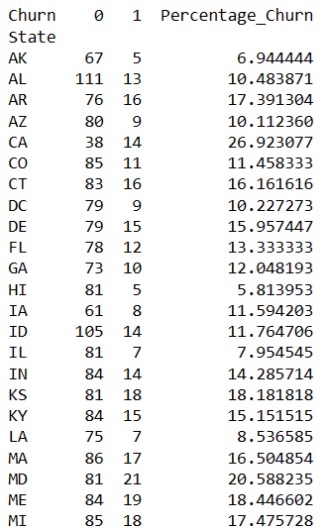
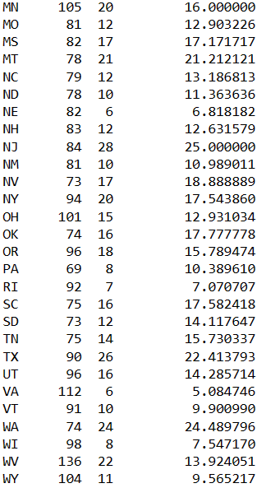
West Virginia has the highest number of customers.
California, New Jersey, Washington , Texas have the higher customer churn rate as compared to others.

Slide 14
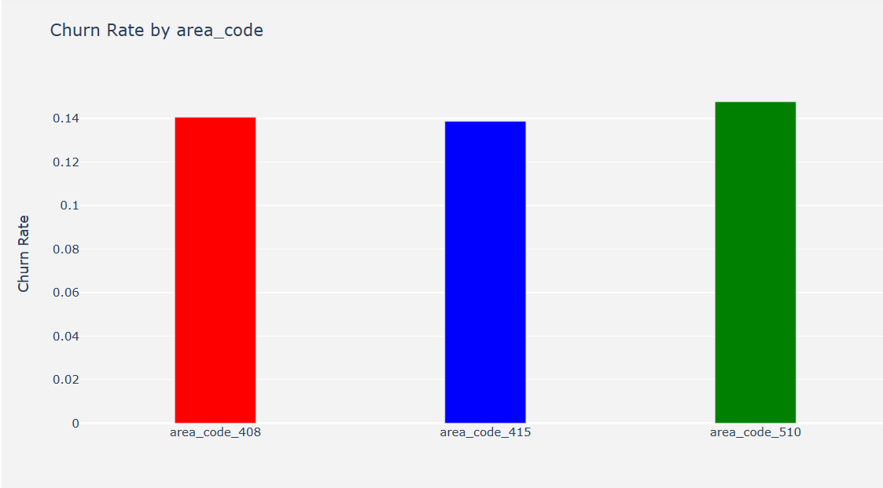
Churn Rate by area_code
From the above graphs, we observe that the attribute 'area_code' does not seem to affect the attribute 'Churn' much.

Slide 15
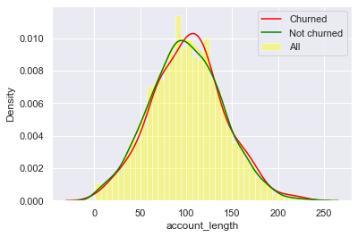
Churn rate and account length
From the above plot, we cannot establish any specific relationship between account length and churn rate.

Slide 16
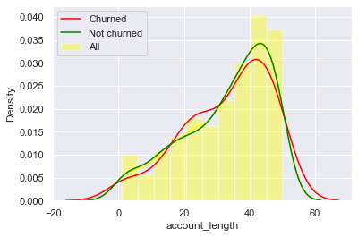
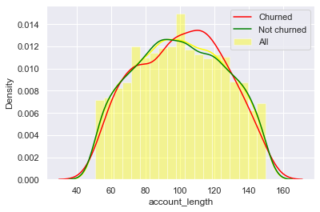
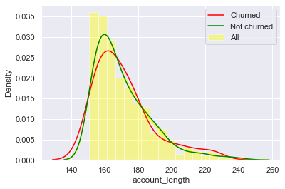
Acc_length from 1 to 50 days
Acc_length from 51 to 150 days
Acc_length from 151 to 200 days

Slide 17
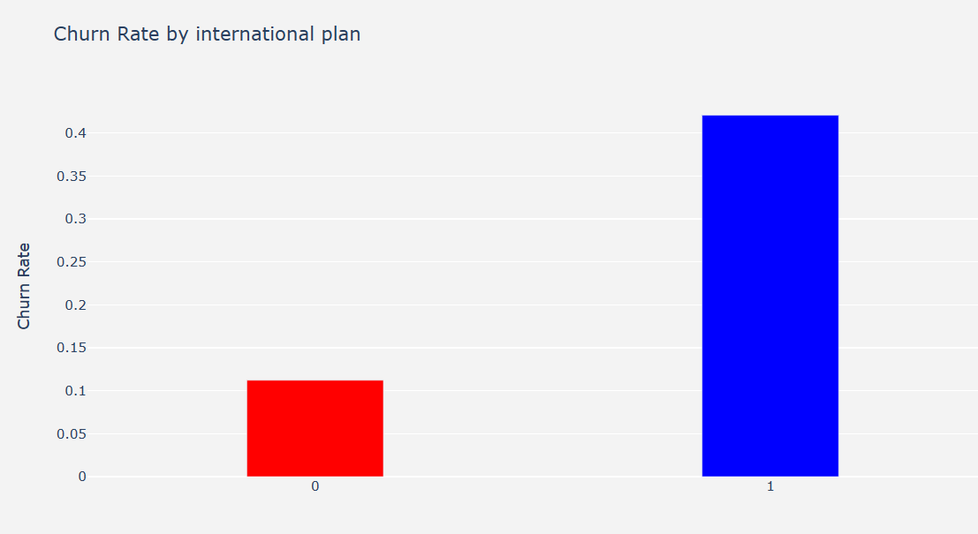
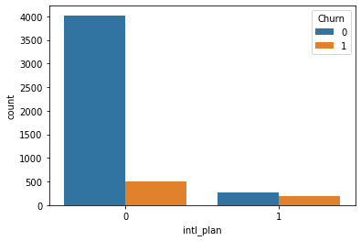
Churn rate and International plan
The churn rate for customers who have opted for international plan is 0.423 that is around 42.3% . So, the customers who have opted for international plan are churning faster.

Slide 18
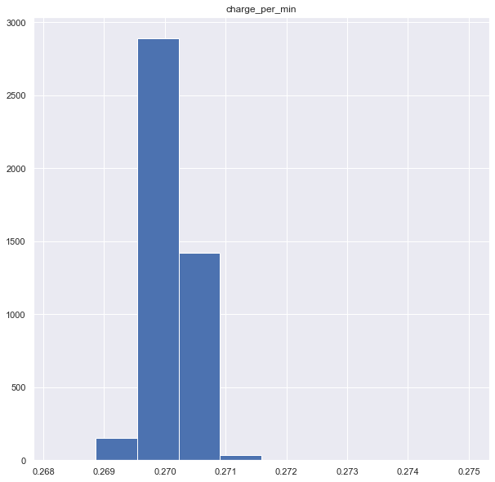
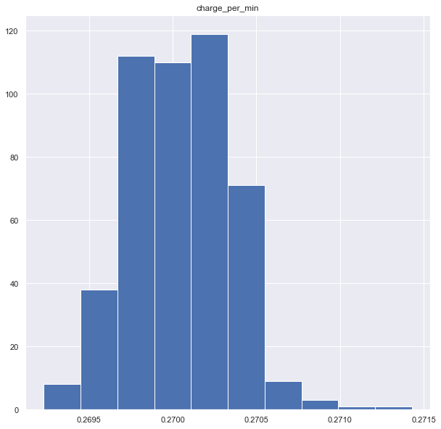
Customers not opting for intl_ plan
Customers opting for intl_plan
Whether the customers are opting or not opting for intl_plan, the charges paid by them per min for international calls is almost same and they all can make international calls. So, the company must specify and take a look at the services offered under intl_plan.

Slide 19
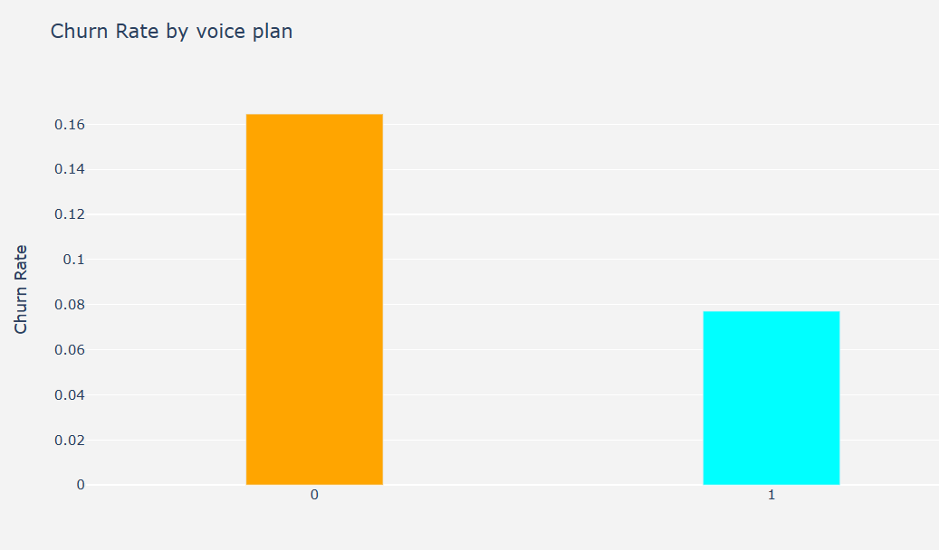
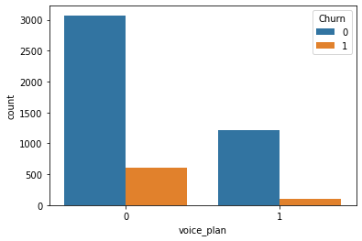
Churn rate and voice plan
The customers opting for voice plan seems to churn less than the customers not opting for the voice plan.

Slide 20
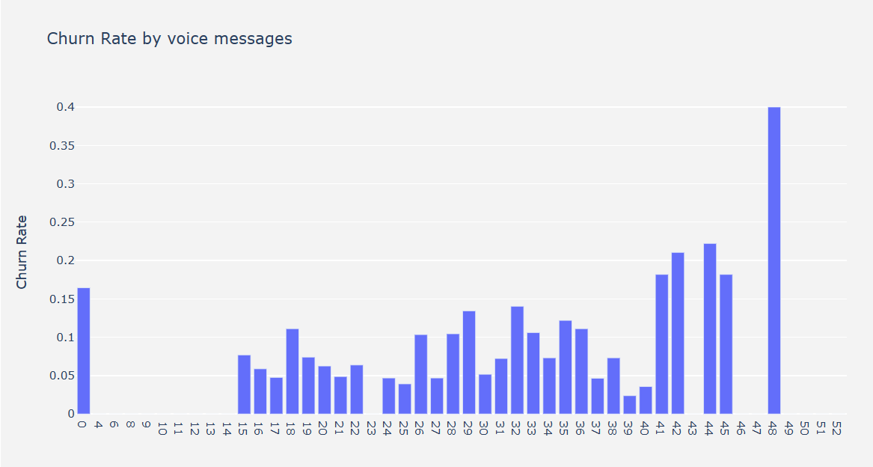
Churn Rate by Voice Messages
Customer churning rate seems to be fluctuating with increasing voice messages.

Slide 21
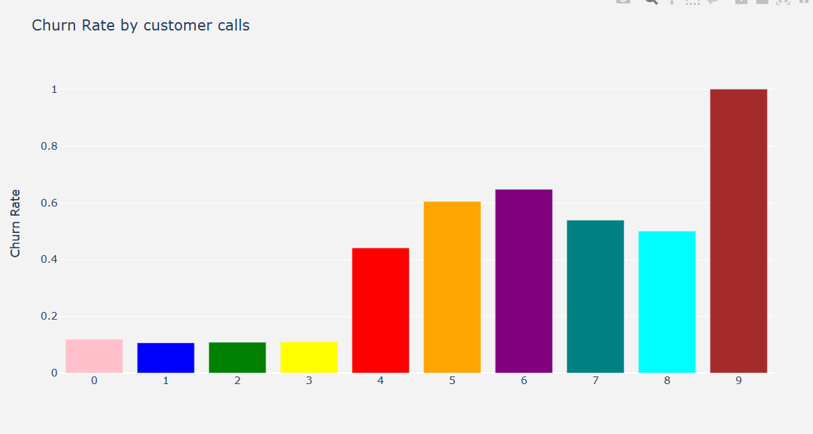
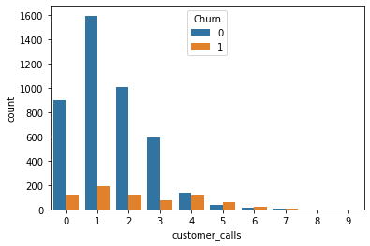
Churn rate and customer calls
It is observed that the customers making more calls to customer service seems to churn more. Also, the customers making only one call also seem to churn indicating that their issue might not be solved by the customer service.

Slide 22
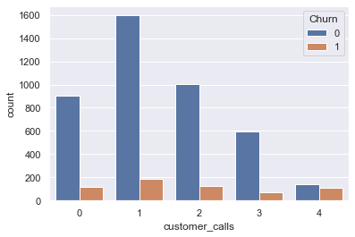
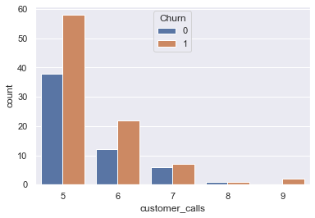
Customer calls < 5
Customer calls >= 5
We can observe that, the customers who are calling the customer service more than 4 times seems to churn at a higher rate.

Slide 23
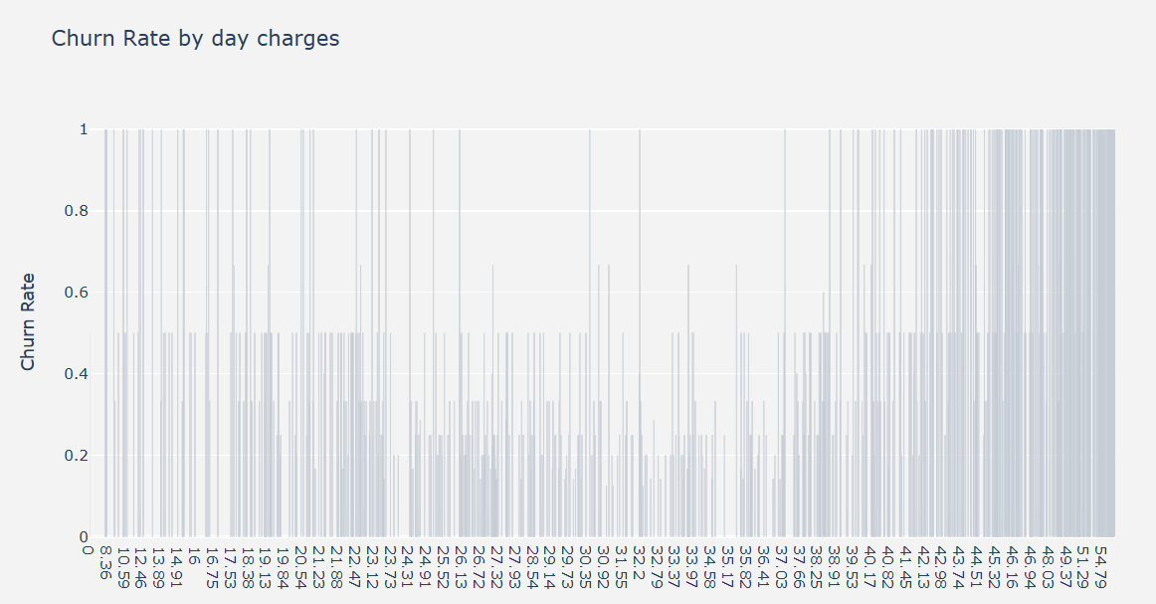
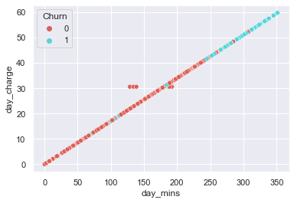
Churn rate and day charges

Slide 24
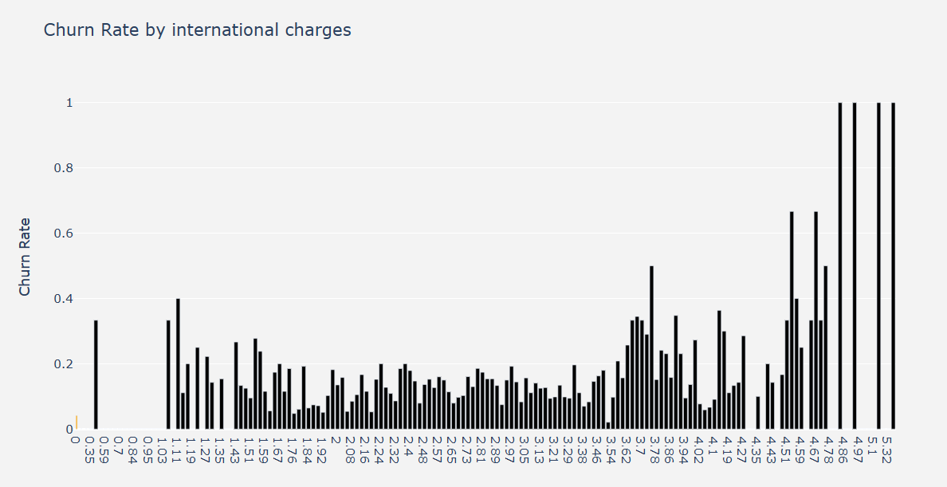
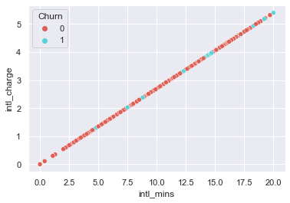
Churn rate and International charges

Slide 25
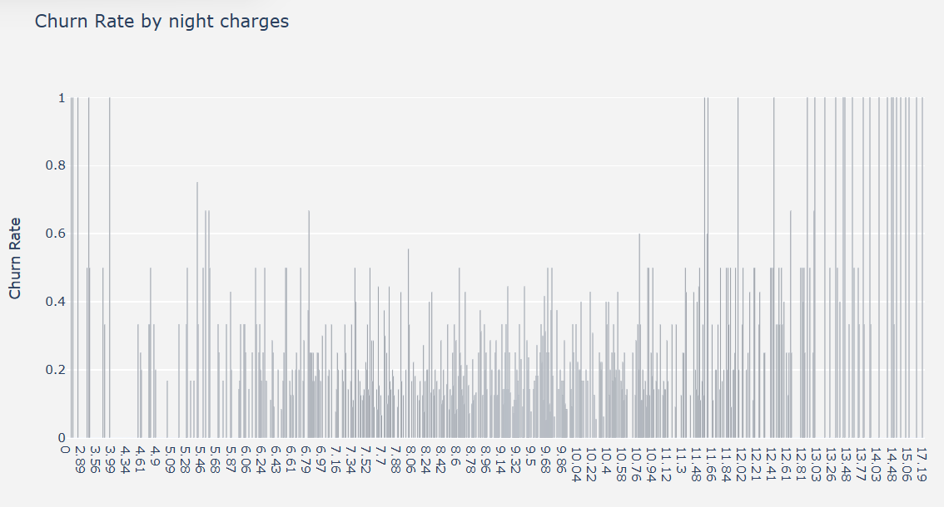
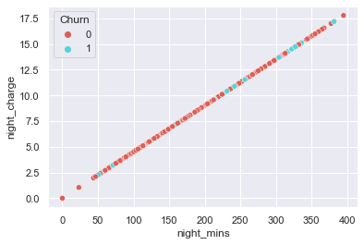
Churn rate and night charges

Slide 26
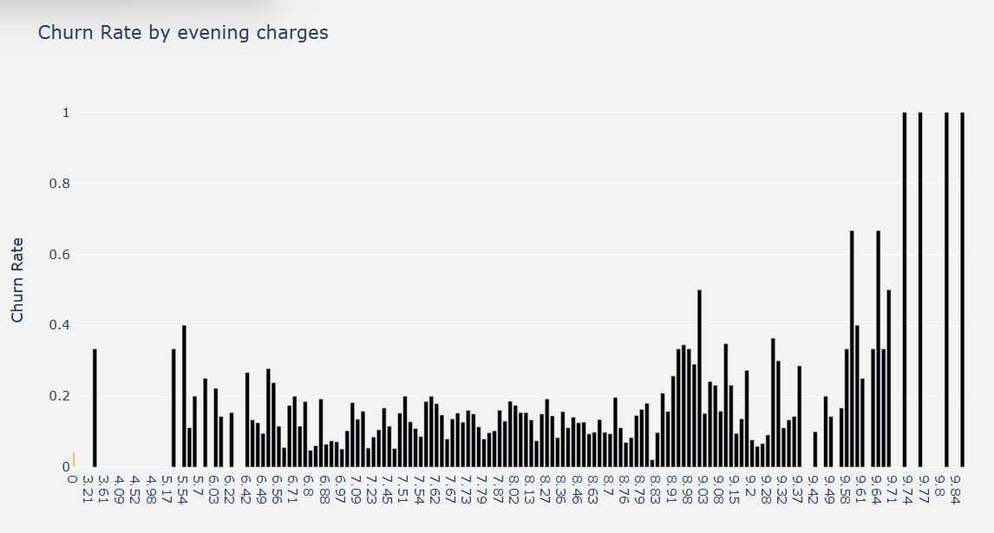
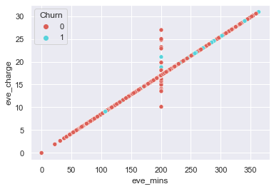
Churn rate and evening charges

Slide 27
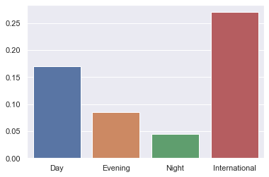
Combined churn rate of day,evening,night,International charges
It is observed that as International charges are very high as compared to other charges,it might be one of the reasons that the customers opting for international plan are churning at a higher rate.

Slide 28
Insights from visualization
According to the given data the total customer churn rate is 14.1% .
There are total 4293 non-churning and 707 churning customers.
The International plan seems to contribute more in churning of customers. Also the international charges are high which could be one of the reason for customer churn. Also this churning due to International plan can occur due to network issue or service issue faced by these customers.
Whether the customers are opting or not opting for intl_plan, the charges paid by them per min for international calls is almost same and they all can make international calls. So, the company must specify and take a look at the services offered under intl_plan.
As the charges are increasing , customers are tending to churn more. Day time call charges is a significant reason for customer churn. So, the company might have to take a look into the call rates charged to the customers and make changes accordingly.

Slide 29
Company should also take steps to improve it’s customer care call service as the customers making even 1 call at the service centre tend to churn indicating either their issue is not solved or there is a delay in solving the issue.
Voice mail plan seems to be popular with the customers.
California, New Jersey, Washington, Texas and Montana are the 5 highest churning states.
These states are located in the coastal area, so the network issue might be one of the
reasons for customer churning in these states.
Whereas Virginia, Hawaii, Nebraska, Alaska and Rhode Island are the 5 least churning states.
The area code and account length does not seem to affect the churn rate.

Slide 30

Feature Engineering

Slide 31
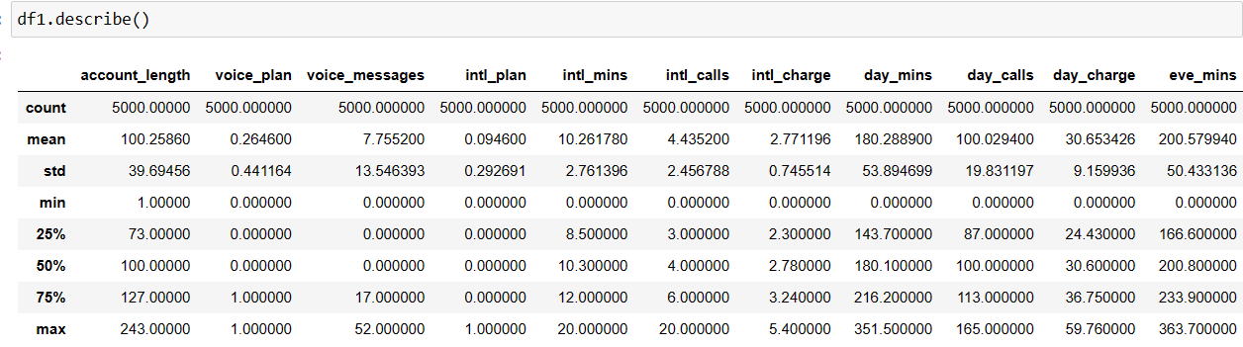
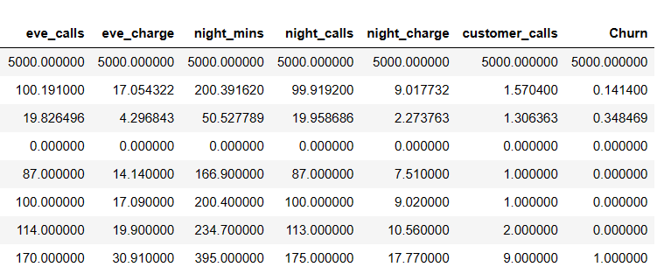
Rescaling the data
We observe that all the attributes are having different range that differs vastly. So it will be better to rescale the data using minmax scaler before model building. We can also use Standard Scaler for this purpose, but it might introduce a negative value in our data which will make it a bit complicated , so we will go with minmax scaler instead.

Slide 32
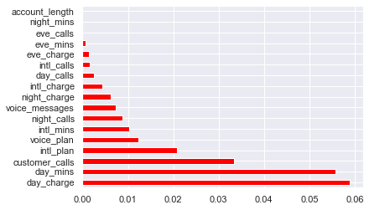
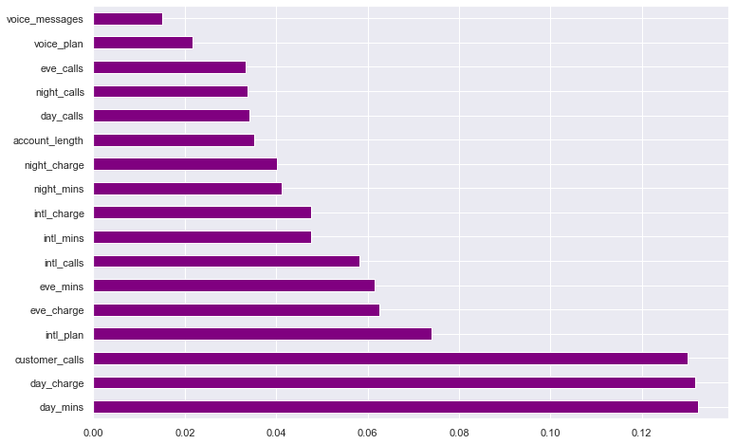
Feature Selection
Mutual_info_classif
Extra Trees Classifier

Slide 33
As stated earlier from EDA, the features ‘State’, ‘acc_length’, ‘area_code’ does not contribute much to model building.
After rescaling the data using the MinMaxScaler, ’mutual_info_classif’and ‘Extra Trees Classifier’ are used to get the information gain from each feature.
Day_charge, day_min, intl_plan, customer_calls came out to be the important features.
However, the results were different from these after adding the new feature
‘total_charge’= day_charge + eve_charge+ night_charge+ intl_charge.
The mutual_info_classif, Extra Tress Classifier and even Recursive Feature Analysis concluded ‘total_charge’, ‘intl_plan’, ‘voice_plan’, ‘customer_calls’ to be the important features.
So, the models are built considering these 4 features.

Slide 34
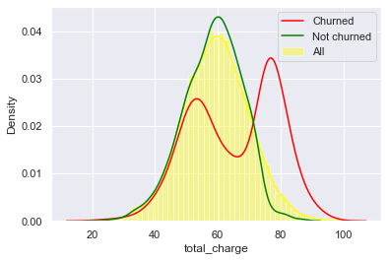
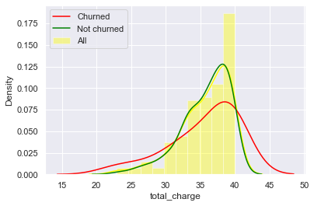
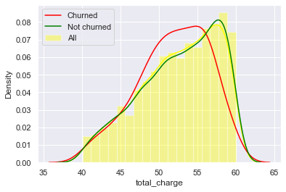
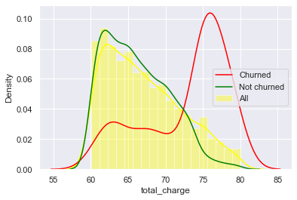
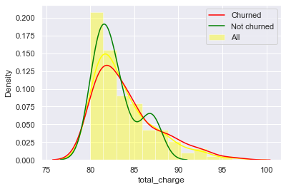
Adding the feature , total_charge = intl_charge + day_charge + eve_charge + night_charge
Between 20 to 40
Between 40 to 60
Between 60 to 80
Between 80 to 100

Slide 35
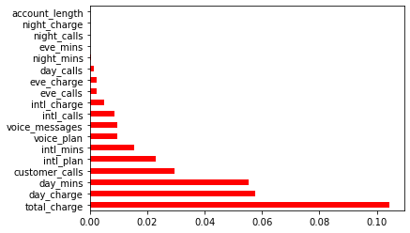
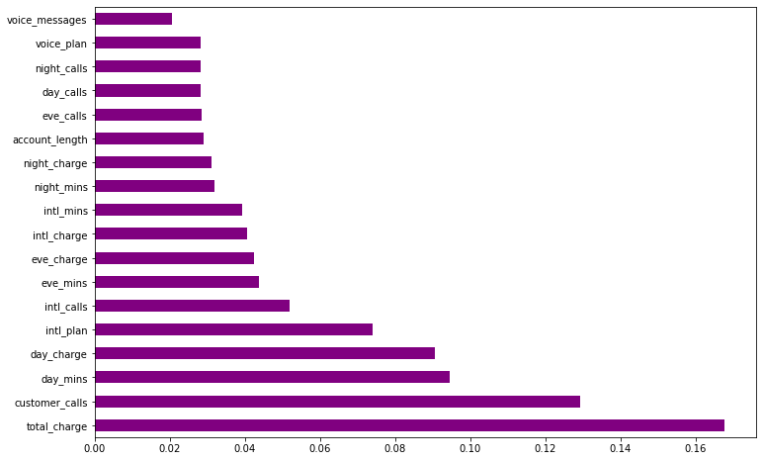
After adding the feature total_charge
Mutual_info_classif
Extra Trees Classifier

Slide 36
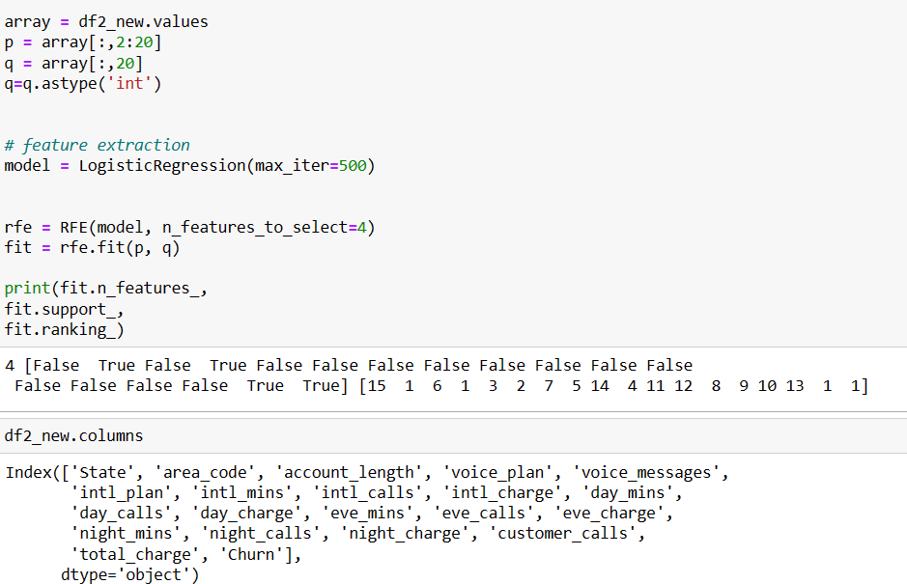
From the above graphs and RFE, we can conclude that
voice_plan, intl_plan, customer_calls , total_charge
are the important features.

Slide 37

Model Building and Validation

Slide 38
All Features
Sr.no. | Model | Accuracy | Precision 0 1 |  | Recall 0 1 |  | F1 score 0 1 |  | Support 0 1
1. | Logistic Regression | 87% | 0.89 | 0.59 | 0.98 | 0.18 | 0.93 | 0.28 | 1298 | 202
2. | KNN | 90% | 0.90 | 0.89 | 0.99 | 0.32 | 0.95 | 0.47 | 1298 | 202
3. | Gaussian NB | 88% | 0.95 | 0.55 | 0.91 | 0.67 | 0.93 | 0.61 | 1298 | 202
4. | AdaBoost | 93% | 0.94 | 0.85 | 0.98 | 0.59 | 0.96 | 0.70 | 1298 | 202
5. | SVM | 92% | 0.92 | 0.88 | 0.99 | 0.47 | 0.96 | 0.61 | 1298 | 202
6. | CART | 96% | 0.98 | 0.81 | 0.97 | 0.88 | 0.97 | 0.84 | 1298 | 202
7. | Random Forest | 98% | 0.98 | 1.00 | 1.00 | 0.87 | 0.99 | 0.93 | 1298 | 202

Slide 39
Stratified Sampling
Sr.no. | Model | Accuracy | Precision 0 1 |  | Recall 0 1 |  | F1 score 0 1 |  | Support 0 1
1. | Logistic Regression | 86% | 0.88 | 0.56 | 0.98 | 0.16 | 0.92 | 0.25 | 1288 | 212
2. | KNN | 94% | 0.94 | 0.92 | 0.99 | 0.63 | 0.97 | 0.75 | 1288 | 212
3. | Gaussian NB | 85% | 0.91 | 0.47 | 0.92 | 0.42 | 0.91 | 0.44 | 1288 | 212
4. | AdaBoost | 91% | 0.92 | 0.76 | 0.97 | 0.49 | 0.95 | 0.59 | 1288 | 212
5. | SVM | 91% | 0.91 | 0.90 | 0.99 | 0.39 | 0.95 | 0.55 | 1288 | 212
6. | CART | 92% | 0.95 | 0.73 | 0.96 | 0.70 | 0.95 | 0.71 | 1288 | 212
7. | Random Forest | 93% | 0.95 | 0.76 | 0.96 | 0.70 | 0.96 | 0.73 | 1288 | 212

Slide 40
Model Building (without applying SMOTE)
Features: intl_plan , voice_plan , customer_calls , total_charge
Sr.no. | Model | Accuracy | Precision 0 1 |  | Recall 0 1 |  | F1 score 0 1 |  | Support 0 1 |  | Fit_time (sec)
1. | Logistic Regression | 87% | 0.88 | 0.59 | 0.98 | 0.17 | 0.93 | 0.26 | 1298 | 202 | 0.01
2. | KNN | 93% | 0.94 | 0.89 | 0.99 | 0.56 | 0.96 | 0.69 | 1298 | 202 | 0.007
3. | Gaussian NB | 86% | 0.91 | 0.46 | 0.92 | 0.45 | 0.92 | 0.45 | 1298 | 202 | 0.007
4. | AdaBoost | 91% | 0.92 | 0.76 | 0.98 | 0.47 | 0.95 | 0.58 | 1298 | 202 | 0.04
5. | SVM | 91% | 0.91 | 0.92 | 0.99 | 0.40 | 0.95 | 0.55 | 1298 | 202 | 0.28
6. | CART | 93% | 0.96 | 0.72 | 0.96 | 0.72 | 0.96 | 0.72 | 1298 | 202 | 0.014
7. | Random Forest | 93% | 0.95 | 0.77 | 0.97 | 0.69 | 0.96 | 0.73 | 1298 | 202 | 0.86

Slide 41
Model Building (after applying SMOTE)
Features: intl_plan , voice_plan , customer_calls , total_charge
Sr.no. | Model | Accuracy | Precision 0 1 |  | Recall 0 1 |  | F1 score 0 1 |  | Support 0 1 |  | Fit_time (sec)
1. | Logistic Regression | 77% | 0.96 | 0.35 | 0.77 | 0.80 | 0.85 | 0.48 | 1298 | 202 | 0.007
2. | KNN | 90% | 0.98 | 0.60 | 0.91 | 0.87 | 0.94 | 0.71 | 1298 | 202 | 0.004
3. | Gaussian NB | 86% | 0.97 | 0.49 | 0.87 | 0.84 | 0.92 | 0.62 | 1298 | 202 | 0.0015
4. | AdaBoost | 89% | 0.97 | 0.56 | 0.90 | 0.84 | 0.93 | 0.67 | 1298 | 202 | 0.021
5. | SVM | 91% | 0.91 | 0.92 | 0.99 | 0.40 | 0.95 | 0.55 | 1298 | 202 | 0.48
6. | CART | 86% | 0.96 | 0.48 | 0.87 | 0.79 | 0.91 | 0.60 | 1298 | 202 | 0.008
7. | Random Forest | 88% | 0.97 | 0.52 | 0.89 | 0.80 | 0.92 | 0.63 | 1298 | 202 | 0.372
8 | KNN (GridSearch) | 91% | 0.98 | 0.62 | 0.92 | 0.85 | 0.95 | 0.72 | 1298 | 202 | 0.004

Slide 42

Model Deployment

